Slide 1
Police Bot: Enhancing Social Media Governance with Policing Bots
Milestone 6 Presentation

Slide 2
Group Members:
Students:
Gabriel Silva
Cody Manning
Liam Dumbell
Nickolas Falco
Faculty Advisor / Project Client:
Khaled Slhoub
Computer Science Project Instructor:
Philip Chan

Slide 3
Overview:
Discussion of Task Completion:
Code Improvements
Testing Metrics
Decide Module
Demo/Commercial
Update on Poster and Ebook Page
Milestone Completion Task Matrix
Advisor Feedback
Lessons Learned

Slide 4
Testing Metrics
Objective: 70%-80% bot detection
Results: 320/424 (bots) - - - - - 76%
Objective: <20% false positives
Results: 102/651 (humans) - - 15%

Slide 5
Code Improvements
Enhanced organisation
Enhanced maintainability
Enhanced reusability
Enhanced Scalability

Slide 6
Decide Module
Decide to report or not a scanned bot:
Scamming Bots or Harassing Bots (Bad)
Are provided with a link to the report page and a tutorial.
Auto Declared Bots or Known Bots (Good)
Ask the user whether to offer the option to report good bots.

Slide 7
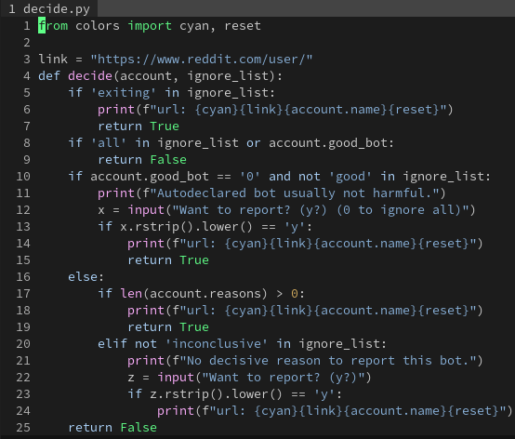
Decide Module

Slide 8
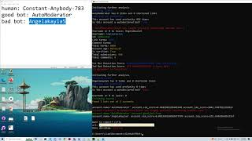
Demo/Commercial
https://youtu.be/LVJUa5dlSaI

Slide 9
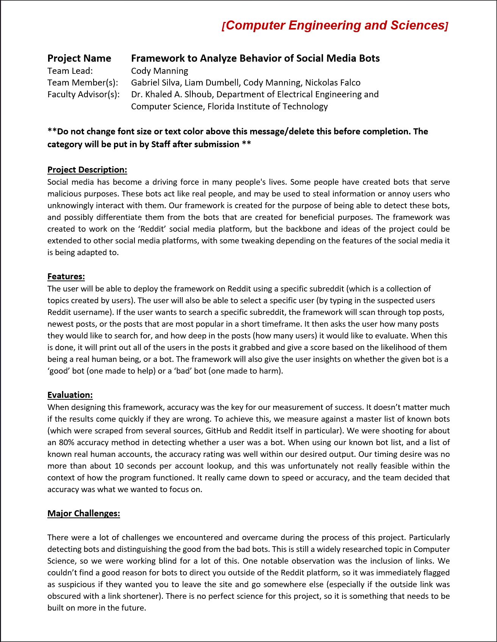
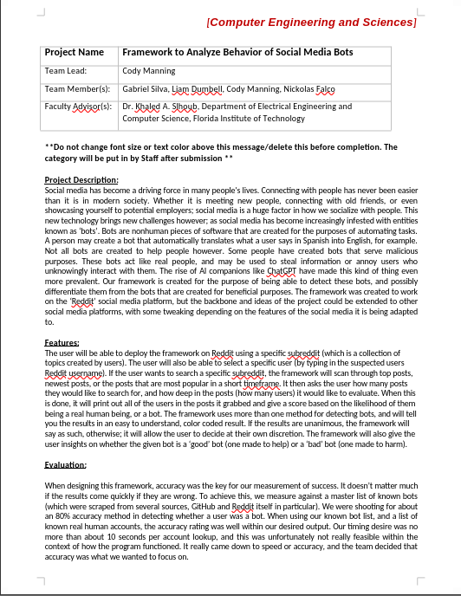
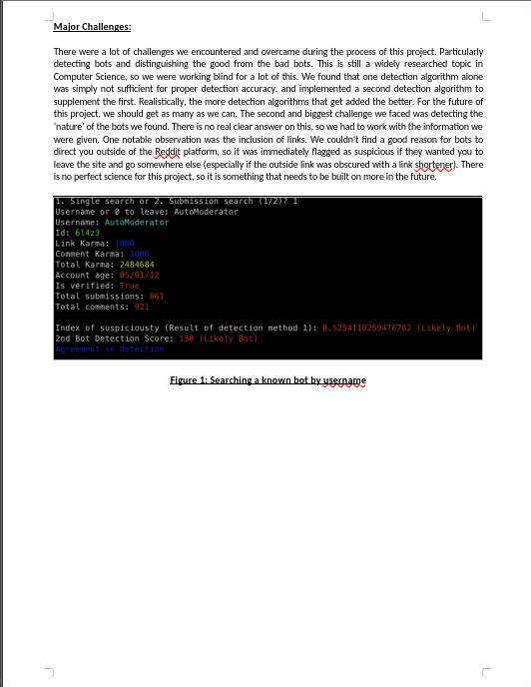
EBook Page

Slide 10
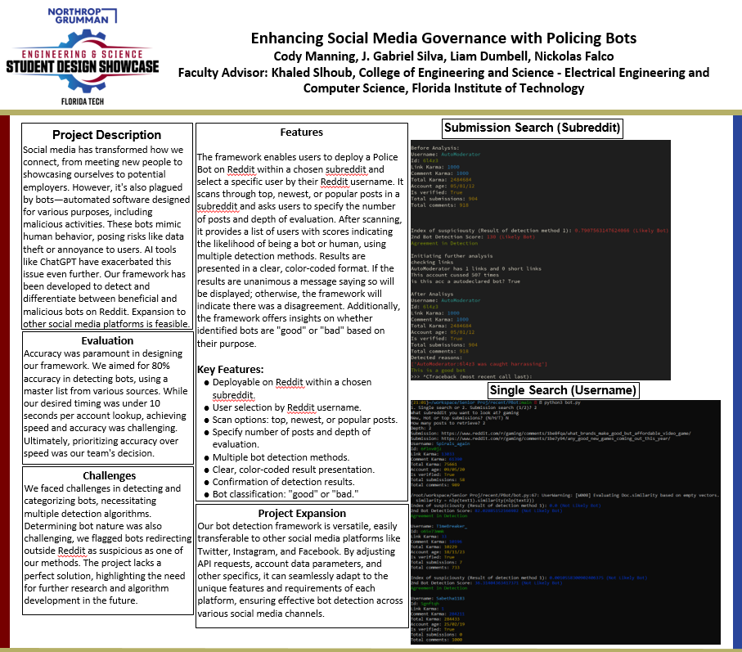
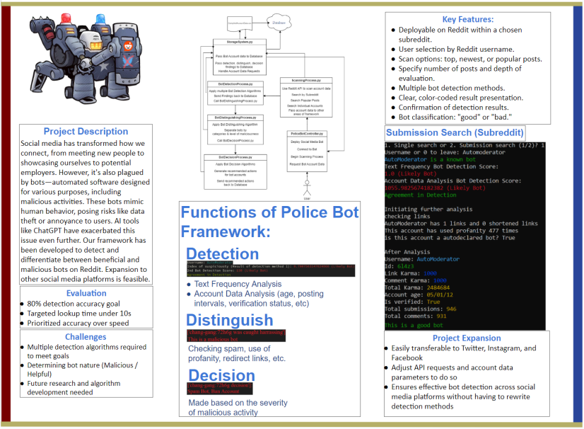
Poster

Slide 11
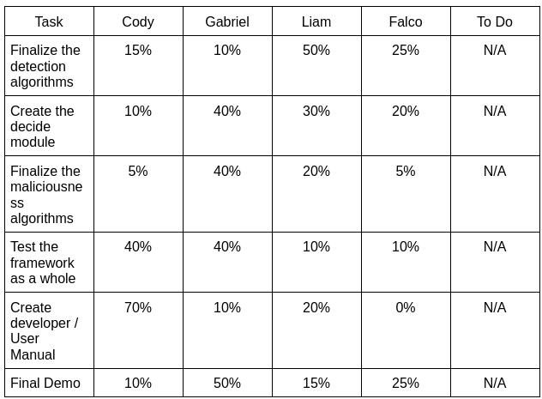
Milestone Completion Task Matrix

Slide 12
Advisor Feedback
Satisfied with our current progress.
As aforementioned in early presentations the project’s goal was to build from the ground up a framework that polices a social media looking for bots
Invited us to continue working on this project even after we are done with the class.
Mentioned writing and publishing a paper with our findings,
Or making the project available to students in the future.

Slide 13
Lessons Learned
This project has been quite an ordeal, as aforementioned in early presentations the project’s goal was to build from the base up a framework that can be improved in the future.
Have a clear plan, and stick to it
Understand API and Platform Limitations
Start early
Test early

Slide 14
This concludes our presentation, Thank You

